Slide 1

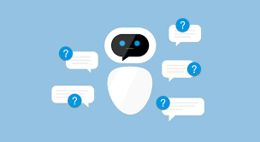
Deep learning CHATBOT
this deep learning chatbot serves to filter and efficiently differentiate adverse effects complaints from people who have been administered a vaccine against a virus

Slide 2
Tech Requirements
Python 3 – Python is a general-purpose interpreted, interactive, object-oriented, and high-level programming language.
Tensorflow – It is an open source artificial intelligence library, using data flow graphs to build models. It allows developers to create large-scale neural networks with many layers.
Keras – API for Deep Learning
Pickle – Python pickle module is used for serializing and de-serializing python object structures. The process to converts any kind of python objects (list, dictionary, etc.) into byte streams (0s and 1s) is called pickling.
NLTK – Natural Language processing ToolKit.
Tkinter – Library for developing GUI

Slide 3
Creating a chatbot in python
Import and load the data file
Preprocess data
Create training and testing data
Build the model
Predict the response
Develop GUI
Run CHATBOT

Slide 4
Importing and loading the data file
First, we will make a file named as “trainingchatbot.py”. We import the necessary packages for our chatbot(nltk, json, numpy, pickle, tensorflow.keras) and initialize the variables we will use in our Python Chatbot. The data file is in JSON format so we used the json package to parse the JSON file into Python.

Slide 5
Preprocessing data
When working with text data, we need to perform various preprocessing on the data before we make a machine learning or a deep learning model. Based on the requirements we need to apply various operations to preprocess the data.
Tokenizing is the most basic and first thing you can do on text data. Tokenizing is the process of breaking the whole text into small parts like words. Here we iterate through the patterns and tokenize the sentence using nltk.word_tokenize() function and append each word in the words list.

Slide 6
Create training and testing data
Now, we will create the training data in which we will provide the input and the output. Our input will be the pattern and output will be the class our input pattern belongs to. But the computer doesn’t understand text so we will convert text into numbers.

Slide 7
Building the model
We have our training data ready, now we will build a deep neural network that has 3 layers. We use the Keras sequential API for this. After training the model for 200 epochs, we achieved 100% accuracy on our model.
We will save the model as ‘chatbot_model.h5’.

Slide 8
Predicting the response
To predict the sentences and get a response from the user we will create a new file “chatbotapp.py”. We will load the trained model and then use a graphical user interface that will predict the response from the bot. The model will only tell us the class it belongs to, so we will implement some functions which will identify the class and then retrieve us a random response from the list of responses. Again we import the necessary packages and load the “words.pkl” and “classes.pkl” pickle files which we have created when we trained our model.
To predict the class, we will need to provide input. So we will create some functions that will perform text preprocessing and then predict the class.
After predicting the class, we will get a random response from the list of intents.

Slide 9
DEVELOPING GUI(GRAPHICAL USER INTERFACE)
Now we will develop a graphical user interface. Let’s use Tkinter library which is shipped with tons of useful libraries for GUI. We will take the input message from the user and then use the helper functions we have created to get the response from the bot and display it on the GUI.

Slide 10
Running chatbot
To run the chatbot, we have two main files; trainingchatbot.py and chatbotapp.py.
First, we train the model(“trainingchatbot.py”) and if we don’t see any error during training, we have successfully created the model.
Then we run the CHATBOT(“chatbotapp.py”)
The program will open up a GUI window within a few seconds. With the GUI we can easily chat with the bot.

Slide 11
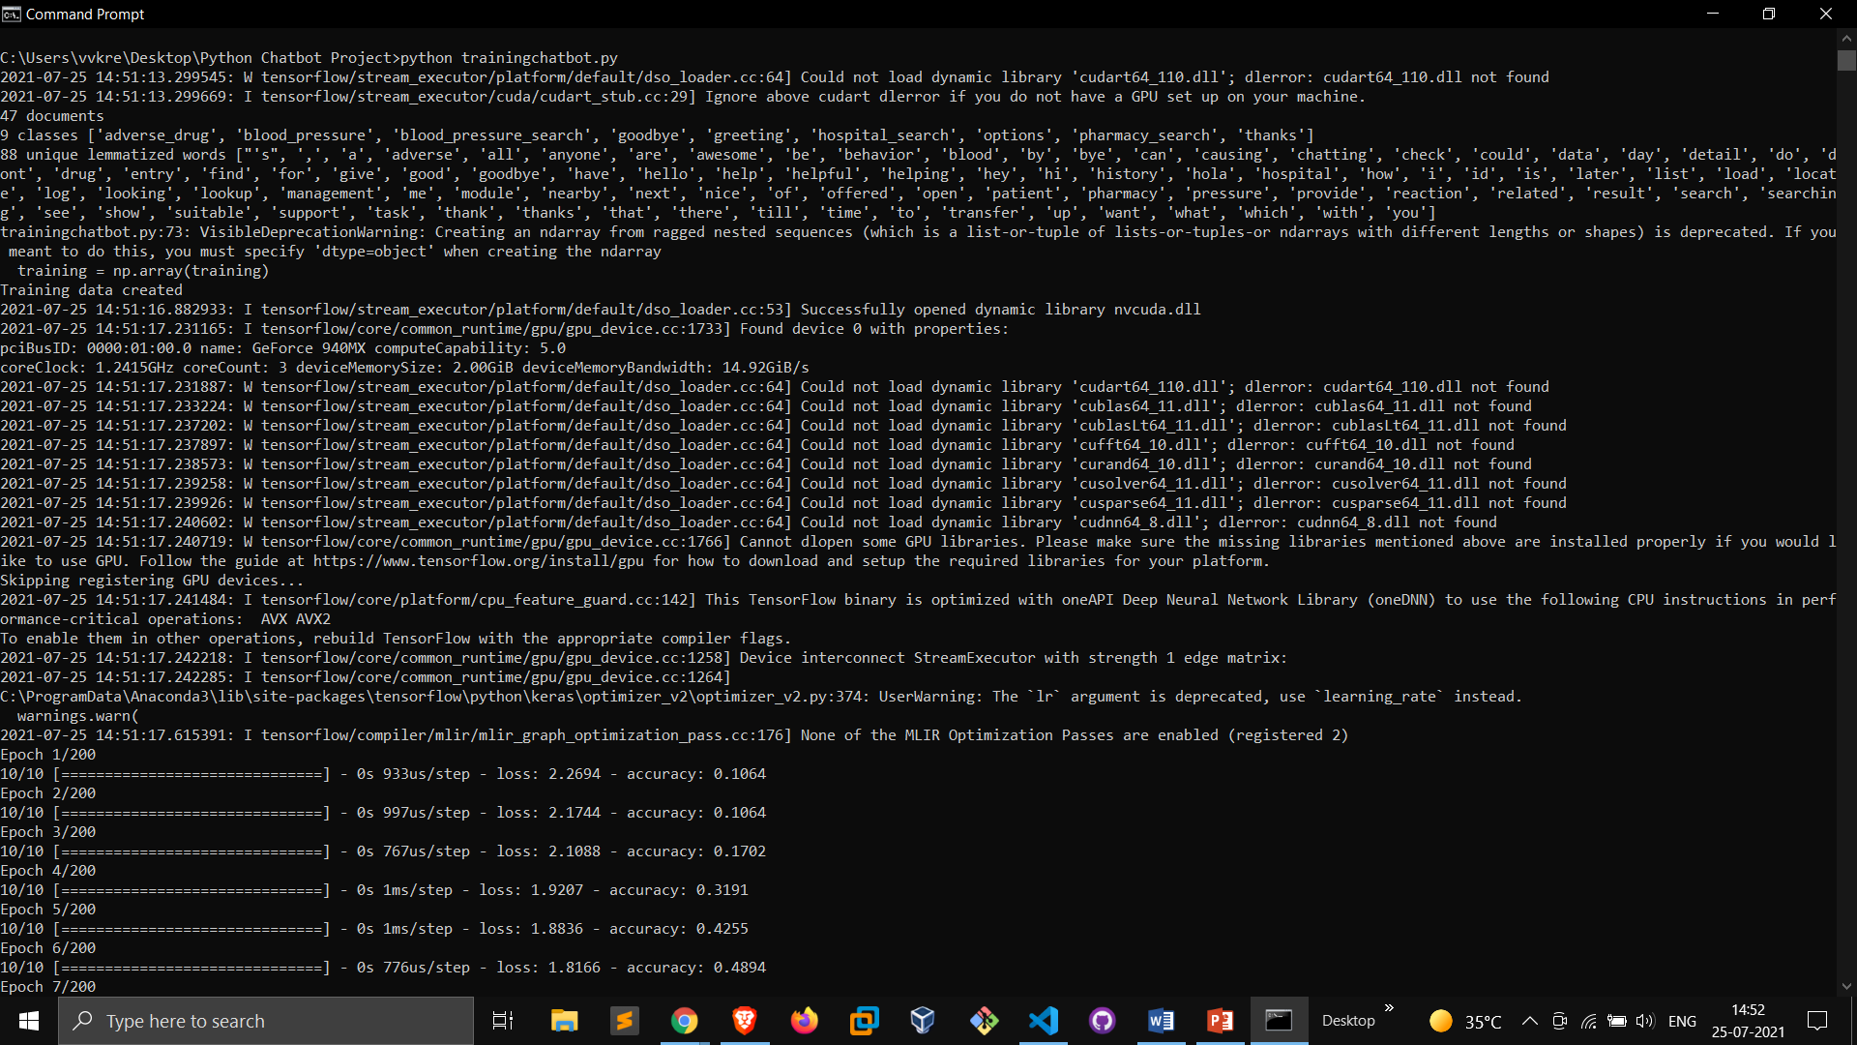
Training chatbot

Slide 12
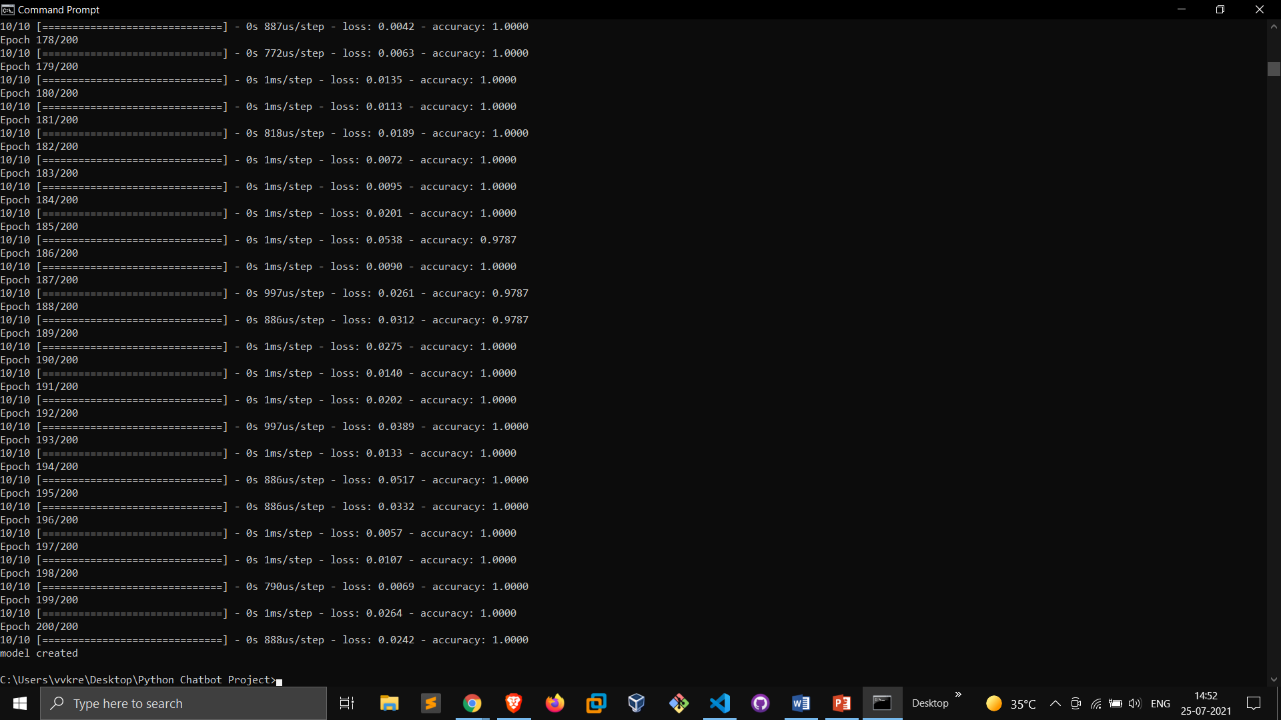
100% accuracy of the model after training the model for 200 epochs
100% Accuracy

Slide 13
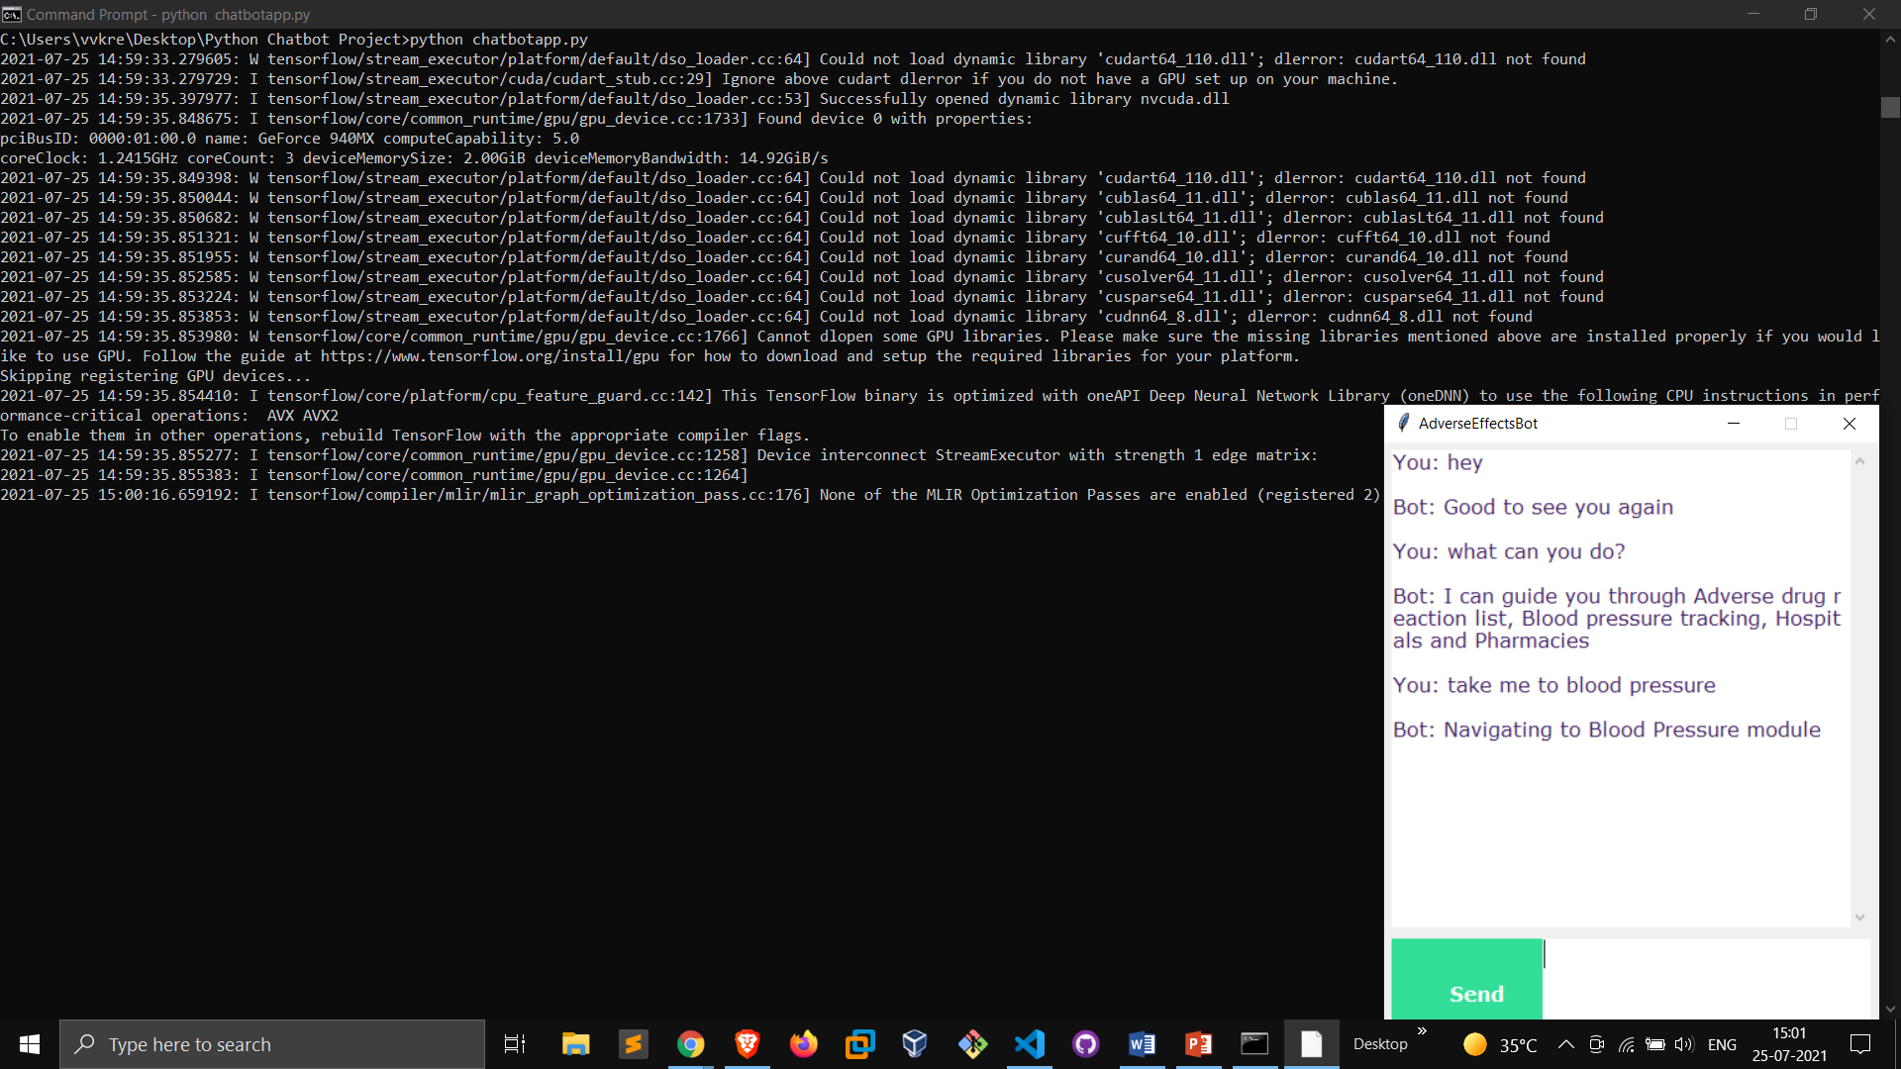
Running chatbot

Slide 14
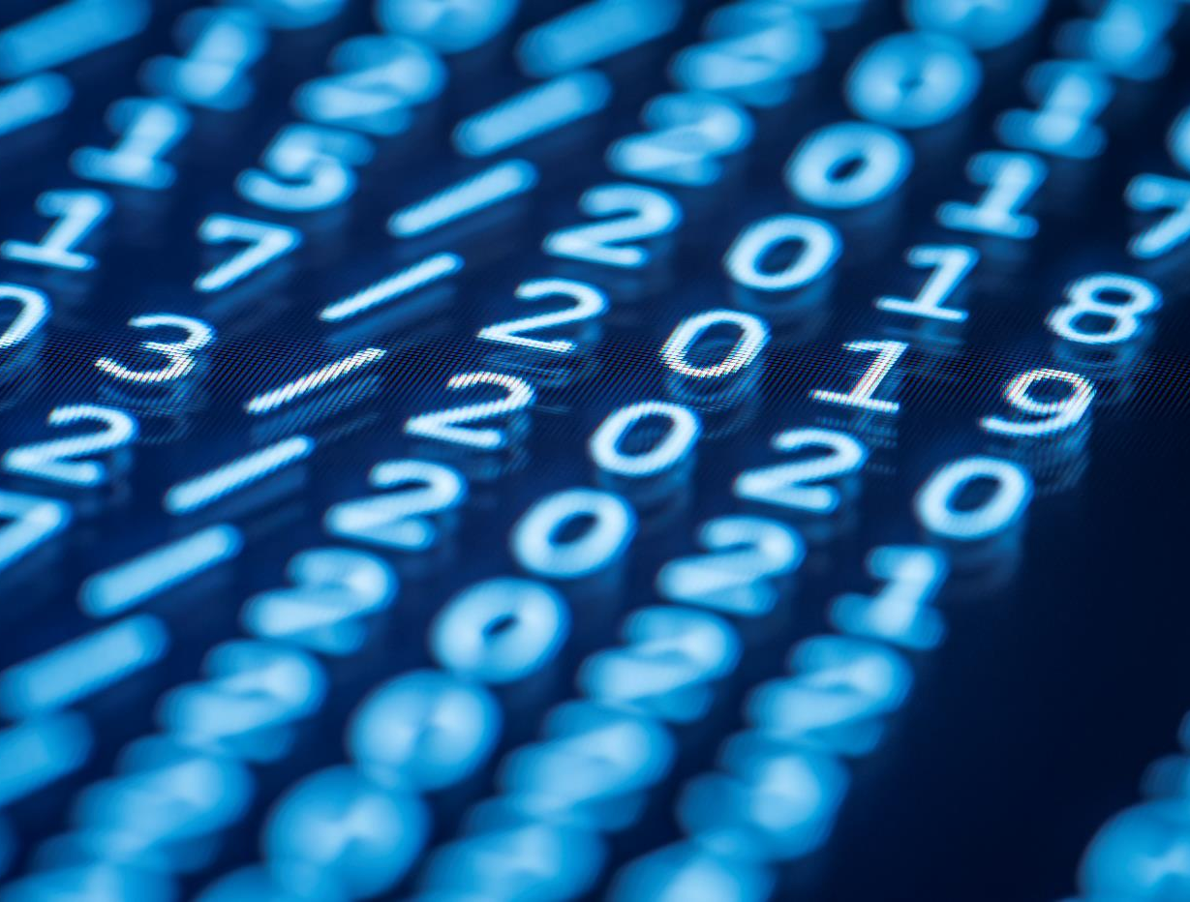
Thank You
By-
Vivek Redhu
19609
Semester 8
Cse-2, uiet, mdu

